Slide 1

SmartShelfX
An Inventory Management Platform
Presented By:
Ayush Badola
Dharani
Nikitha
Prasanth
Sri Renuka Shambavi
Mentor: Suramya Biswas

Slide 2
Agenda
01
02
Introduction
Technology Stack
Platform overview and core capabilities
Modern architecture powering the system
03
04
Implemented Modules
Key Outputs
Six key functional components
User interfaces and system capabilities
05
06
Future Enhancements
Conclusion
Roadmap for continuous innovation
Strategic value and next steps

Slide 3

Introduction
SmartShelfX is an advanced inventory management system built to simplify product tracking and restocking operations.
It helps organizations monitor stock levels, manage vendors, record transactions, and analyze product demand when inventory levels drop below a certain reorder level.
The system provides a Centralized dashboard and role based navigation where users can easily track product details, analyze product demand , view supplier activity, and manage day-to-day inventory processes.

Slide 4




Technology Stack
Frontend
Backend
Reactjs Application
Java with Spring Boot Framework
Responsive and dynamic interface for smooth user experience
Also uses Spring Security, Spring Data JPA to handle
authentication, business logic and database operations
Database
Visualization
MySQL
Chart.js
Manages product details, stock transactions, and user records
Dynamic data visualization and analytics reporting
IDE : VS Code and Eclipse is used for convenient development of frontend and backend

Slide 5
Implemented Modules
1
2
User & Role Management
Inventory Catalog
Secured login with role-based dashboards for Admin, Manager, and Vendor access
Complete product lifecycle: add, edit, delete items with SKU tracking and vendor tracking
3
4
Stock Transactions
Restocking Status
Real-time recording of stock-in shipments and stock-out dispatches with date and vendor tracking
Restock recommendations are given automatically by adding status of the products
based on stock available .
5
6
Alerts & Notifications
Analytics Dashboard
Proactive low-stock warnings, validations, alerts and vendor tracking with dismissible notifications
Comprehensive reports with inventory trends, purchase/sales comparisons and demand
of single product using charts.

Slide 6
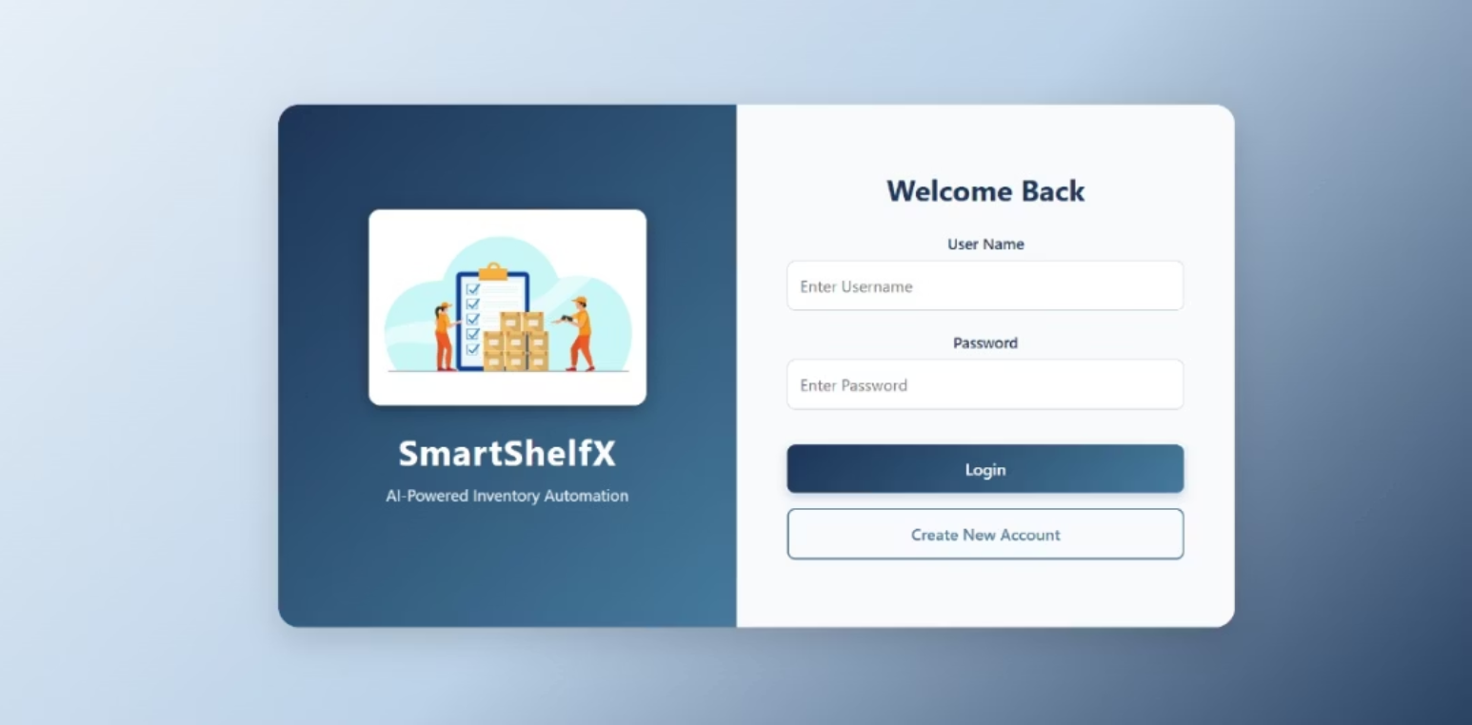
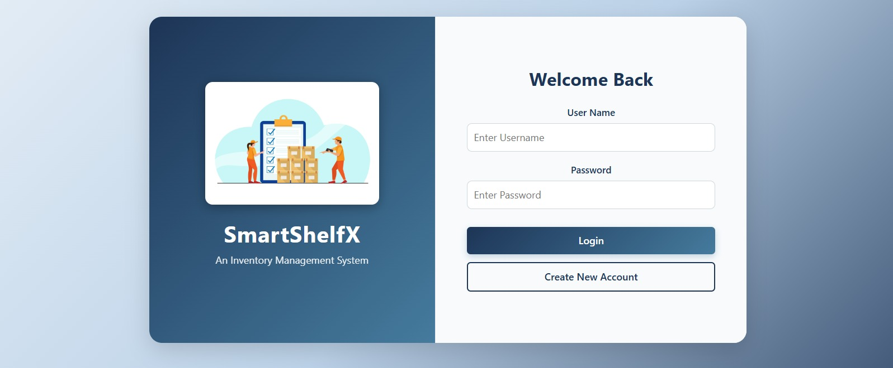
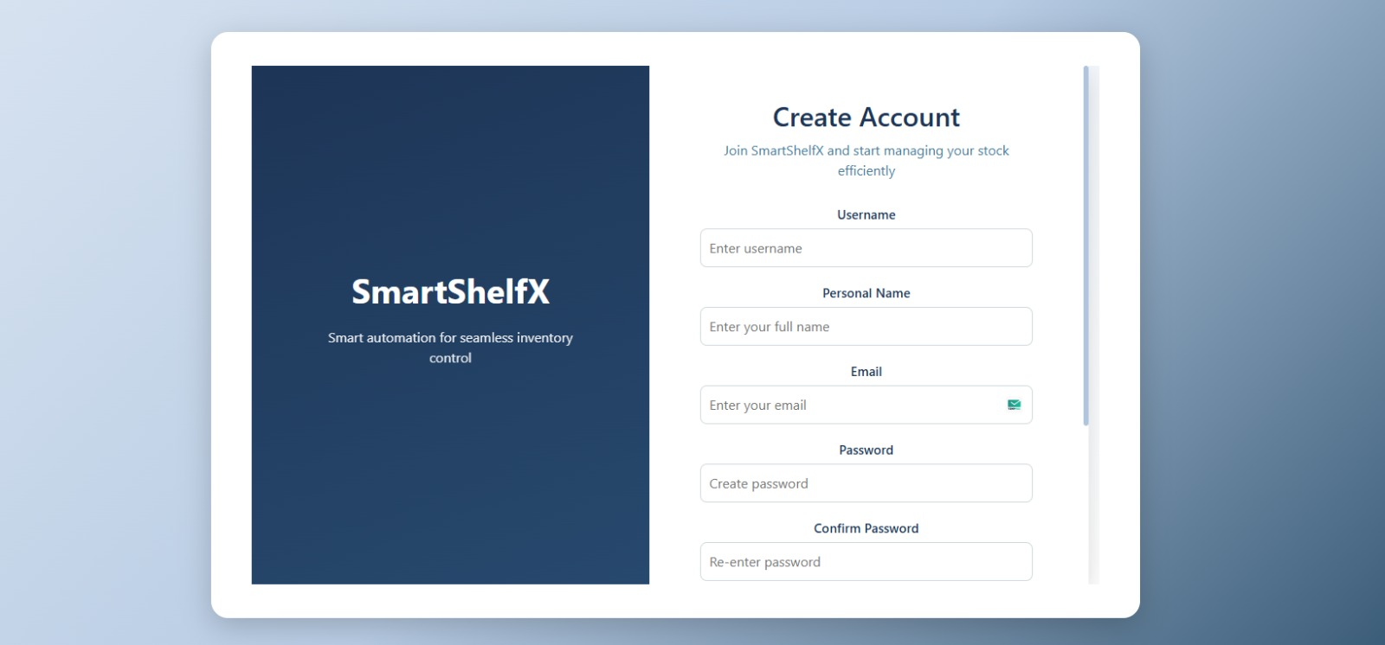
Key Outputs
Login interfaces designed with simplicity, provides role-based access handled entirely on the frontend. Roles include Admin, Manager and Vendor
The system allows users to register with confidence while maintaining data protection and integrity. It also supports in mobile view.

Slide 7
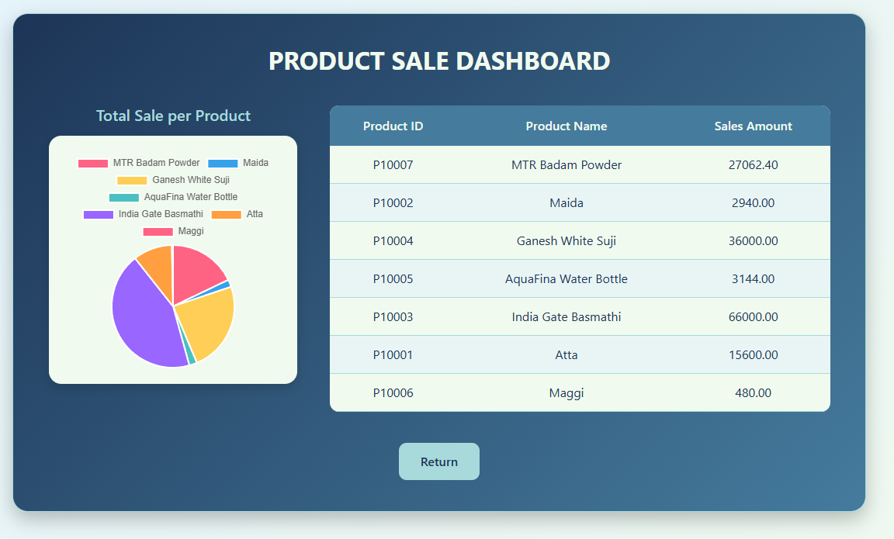
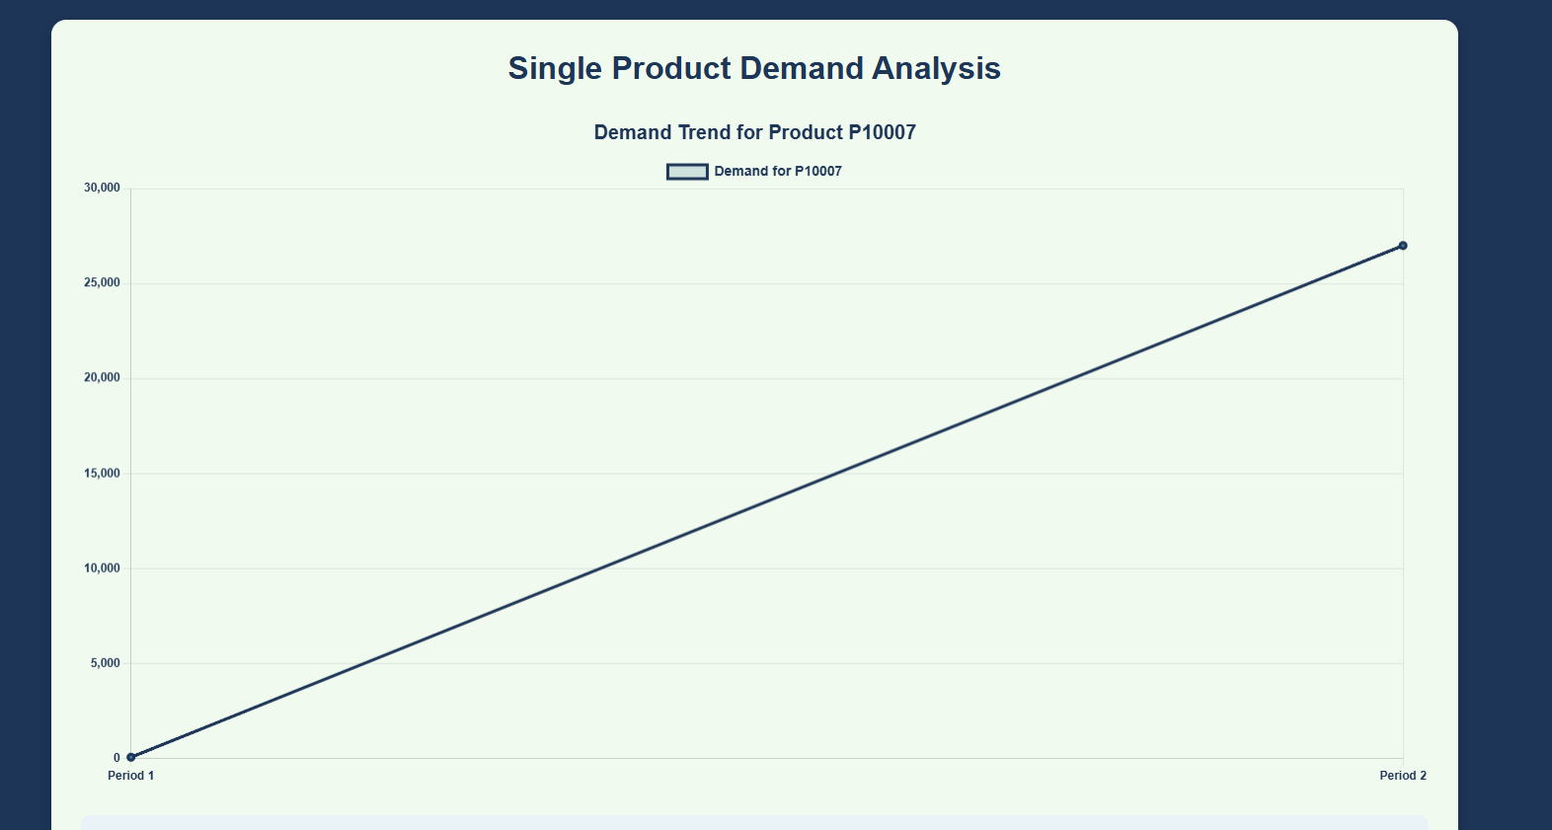
Key Outputs​
Product Demand Analysis
Product analysis in SmartShelfX visualizes key insights from the Transaction table using Pie and Line charts.
The Pie Chart highlights total sales of all products, while the Line Chart shows demand trends for specific products over time.
These insights help identify top-selling items, monitor demand fluctuations for efficient inventory management.

Slide 8
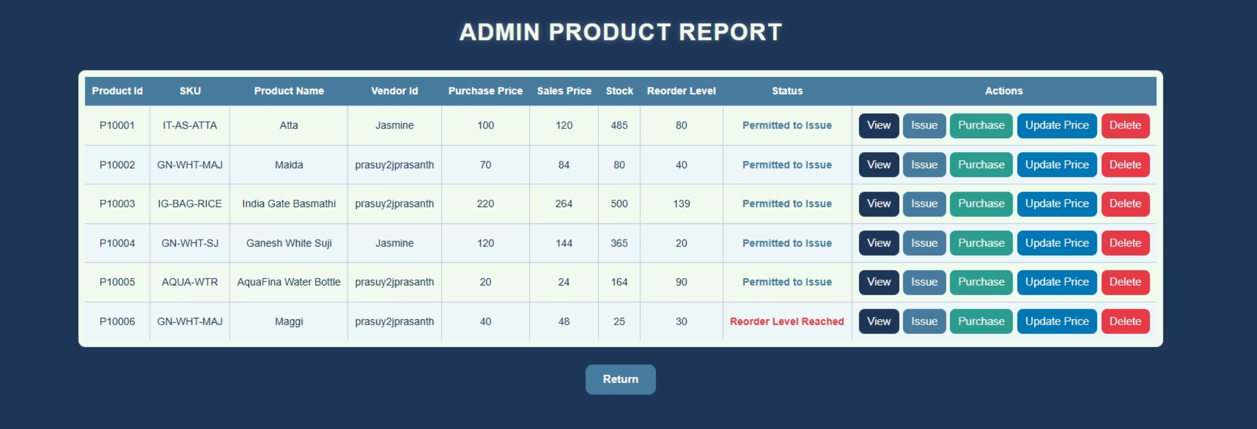
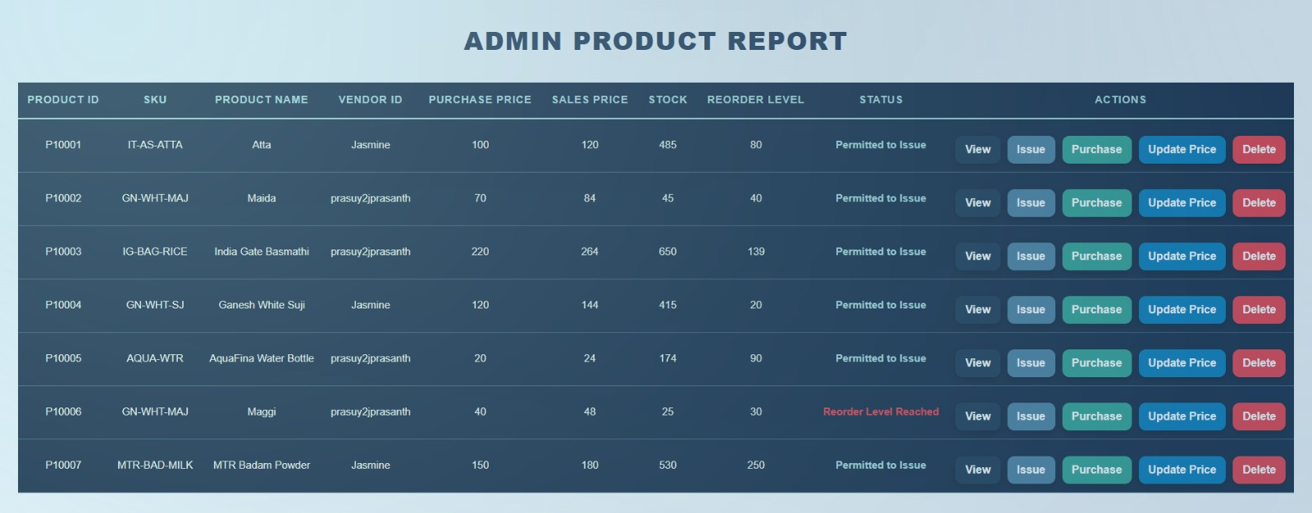
Key Outputs
User Experience & Interface Highlights
Secure Login & Dashboard
Product Management
Transaction History
Intuitive access with role-based dashboards and role based access to operations on Stock keeping unit (SKU) and product.
Comprehensive product forms and tables with all actions together with Stock Status and product details
Detailed stock-in/out forms with complete transaction logs, quantities, and handler information

Slide 9




Future Enhancements
Mobile Application
Native iOS and Android apps for on-the-go inventory management and real-time stock monitoring with batch csv file importable.
IoT and AI Integration
RFID and sensor-based stock tracking for hands-free inventory updates with accuracy and AI for automatic restocking operations.
Vendor Portal
Dedicated interface for vendors to manage orders, update inventory, and communicate directly with warehouse teams
Multi-Location Support
Enterprise-level warehouse network management with centralized control and distributed operations

Slide 10


Conclusion
Transforming Inventory Management Lifecycle
SmartShelfX delivers a comprehensive, Automated solution that eliminates guesswork from inventory management.
Minimize Stockouts
Scalable
Predictive alerts prevent out of stock
Optimized inventory management easy to
integrate future enhancements
Automate Operations
Automatically updates data like stock level and history reducing manual work
Ready for deployment: Modern architecture, proven technologies, and scalable design position SmartShelfX as the future of intelligent inventory management.

Slide 11


